Slide 1



Uber’s Pickup Analysis

Slide 2
Presented By:
Omkar Balwant Jadhav
M.Sc. Tech (Mathematics) Part - III
Year (2022-23)

Slide 3

About Company
Next Innovate Techno Solutions is one of renowned IT Company in Roorkee. Our company provides a number of IT, Web, Writing and Learning solutions. Our team works with their best to provide you with IT services. We have an expert team of creative designers, skilled developers, Experienced writers and well trained staff.
NITS is an Ed-Tech Online Platform where we offers various training services to all the candidates as well as to the working professionals. NITS is an ISO 9001:2015 Certified Company
• Training · Development · Business Solutions

Slide 4
Introduction
Uber was founded by Travis Kalanick and Garrett Camp in 2009, and it was already one of the fastest-growing companies in the world. In Boston, UberX claims to charge 30% less than taxis – a great way to get customers' attention. Nowadays, we see applications of Machine Learning and Artificial Intelligence in almost all the domains so we try to use the same for Uber cabs price prediction. In this project, we did experiment with a real-world dataset and explore how machine learning algorithms and Data Science could be used to find the patterns in data. We mainly discuss about the price prediction of different Uber cabs that is generated by the machine learning algorithm.

Slide 5

Aim
Complete Data Analysis and Exploration of Uber Dataset

Slide 6



Data Set :
CSV Format
Shape of Dataset:
322844,56

Slide 7

Libraries

Slide 8
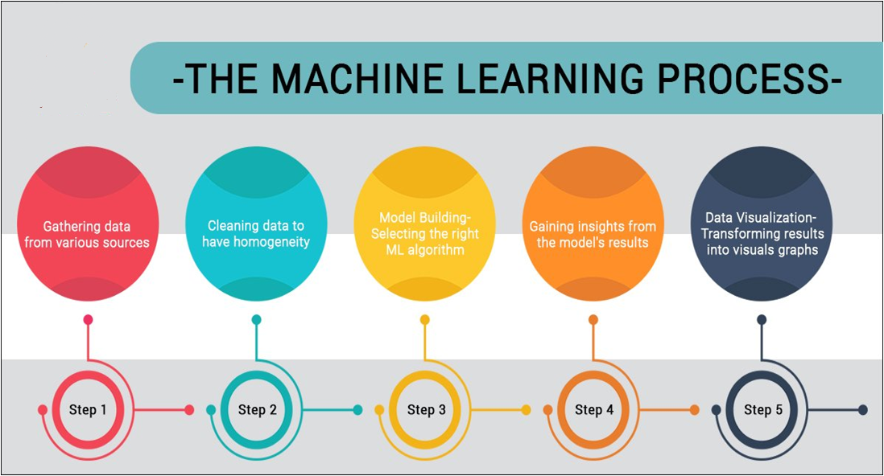

Slide 9
Exploratory Data Analysis
1. Data Preparation
2. Discover Patterns
3. Statistical Summary
4. Handling NaN Values
5. Graph Reports

Slide 10
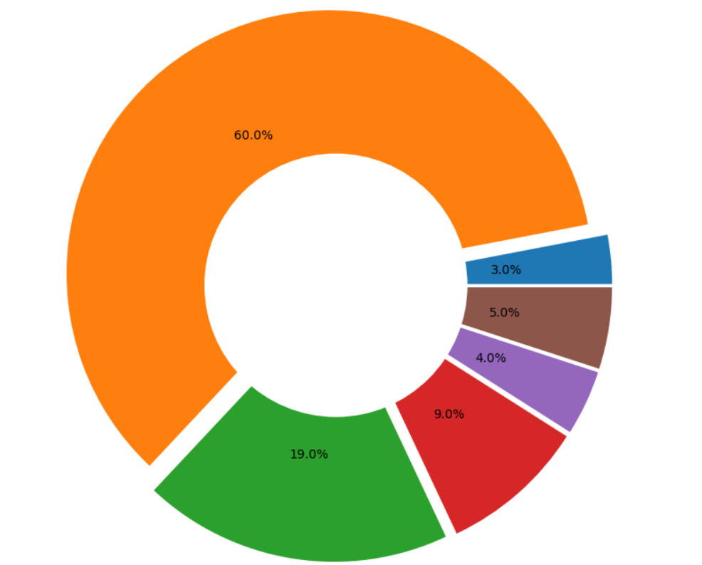
Feature Engineering Courtesy of Digitalag
Cleaning and Organizing Data : 60.00%
Collecting Data From Dataset : 19.00%
Mining Data For Patterns : 9.00%
Refining Algorithm : 4.00%
Building and Training Data : 3.00%
Others : 5.00%

Slide 11
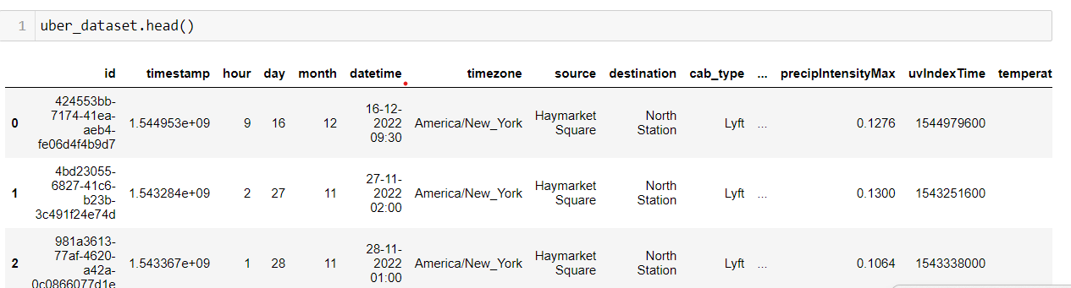
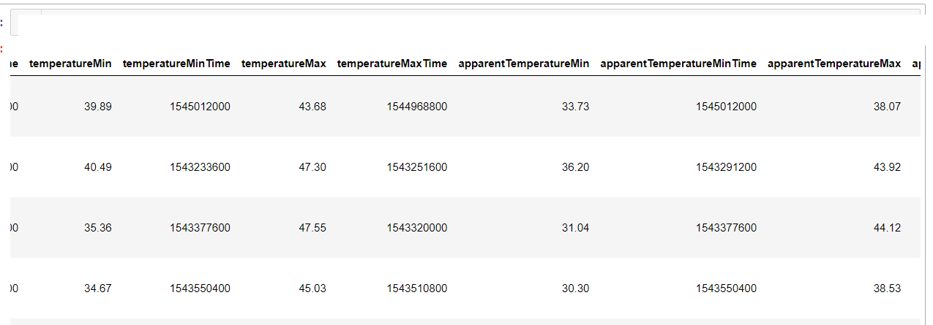
Data Preparation

Slide 12
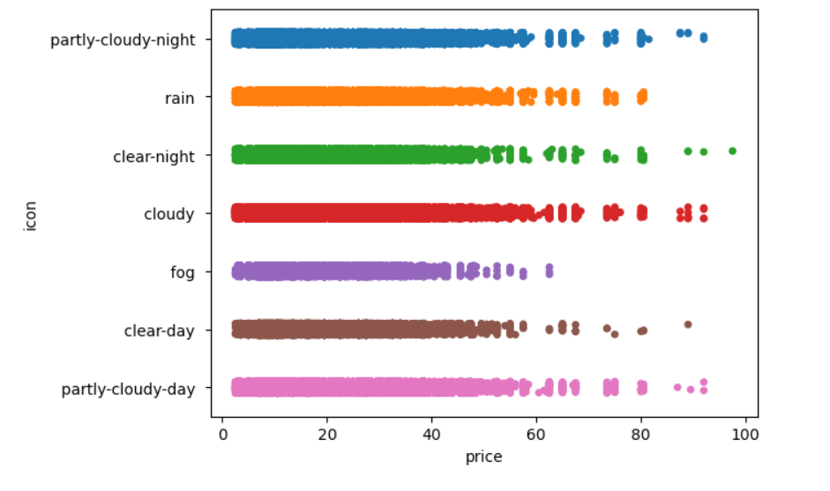
Data Visualization
1.ICON V/S PRICE

Slide 13
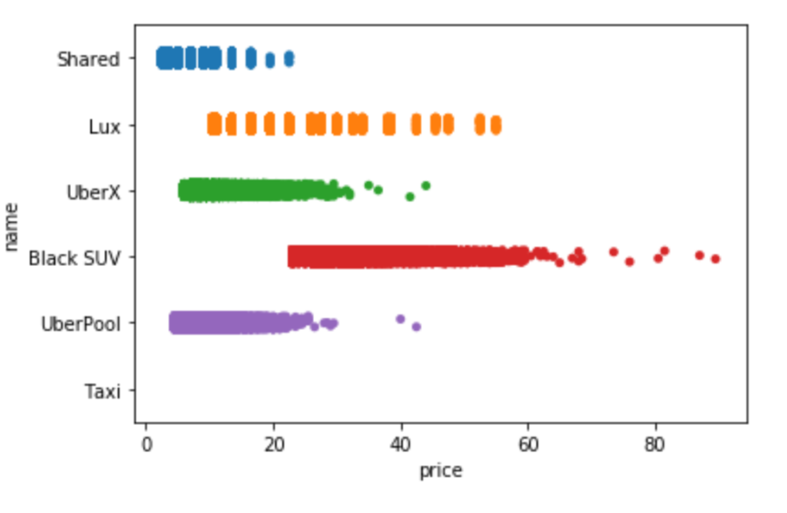
2. NAME V/S PRICE

Slide 14
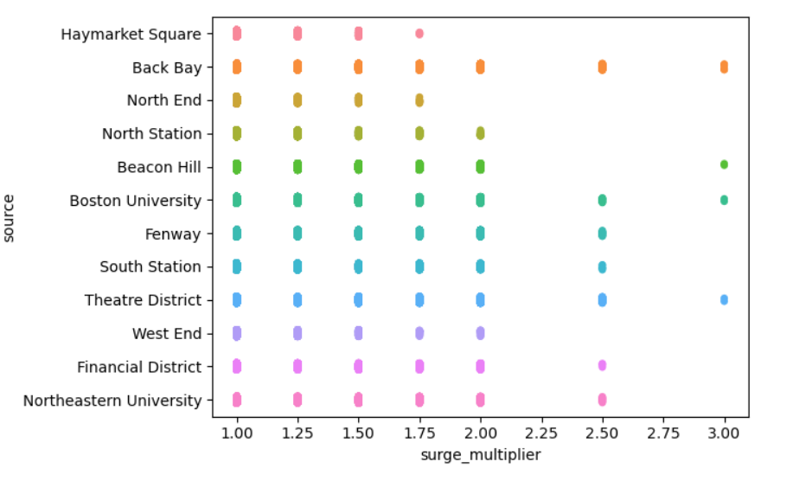
3. SOURCE V/S SURGE MULTIPLIER

Slide 15
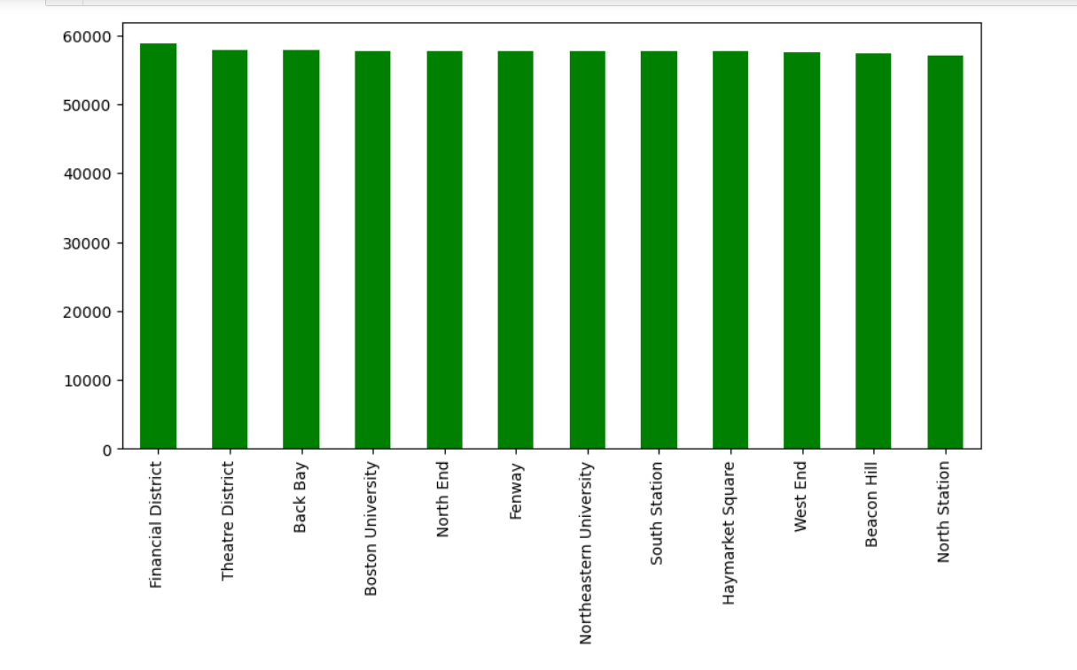
4. LOCATION

Slide 16
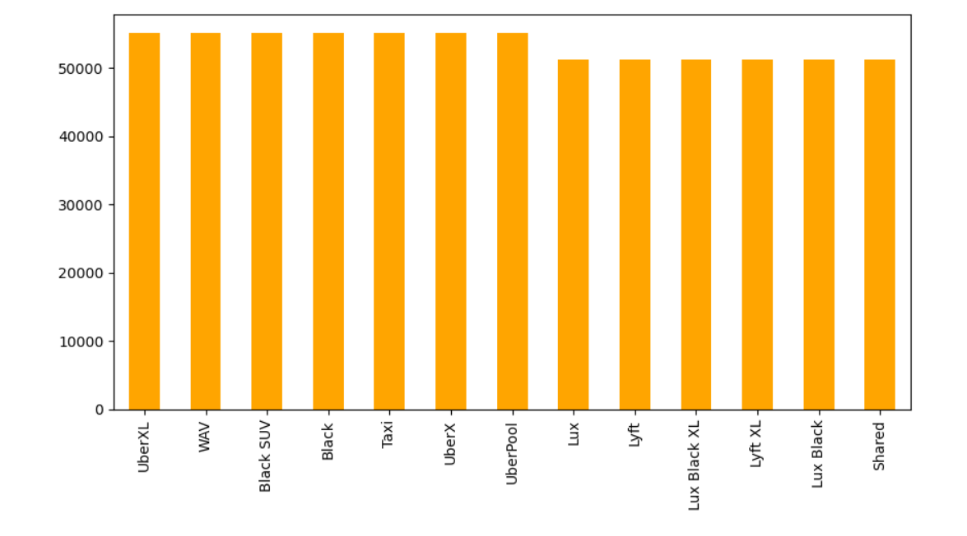
5. VEHICLES

Slide 17
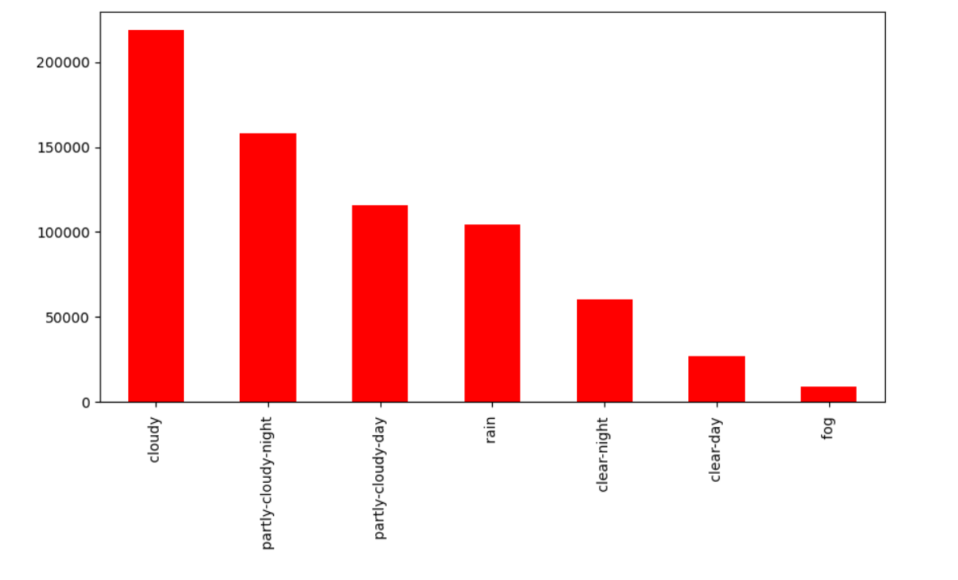
6. WEATHER EFFECT

Slide 18
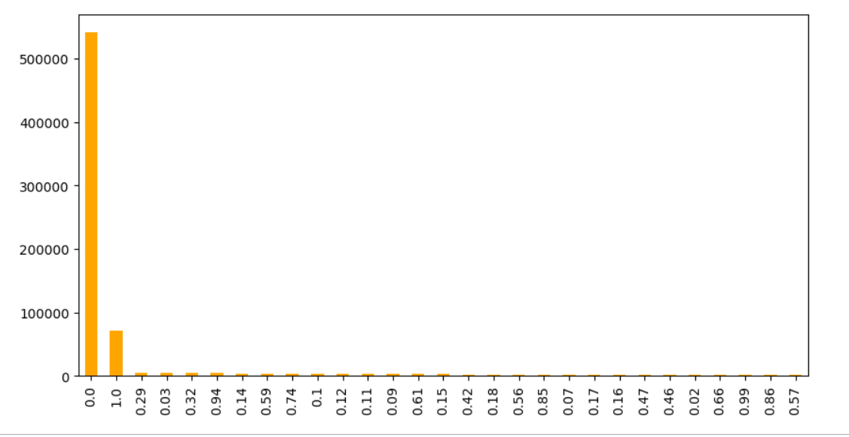
7. PRECIP PROBABILITY

Slide 19


Label Encoding
Label Encoding refers to converting the labels into numeric form
so as to convert it into the machine-readable form

Slide 20
RFE (Recursive Feature Elimination)
RFE is a wrapper-type feature selection algorithm.
There are two important configuration options when using RFE:
• The choice in the number of features to select (k value)
• The choice of the algorithm used to choose features.
Achieved by fitting the given machine learning algorithm used in the core of the model, ranking features by importance, discarding the least important features, and re-fitting the model

Slide 21
After applying RFE on given data set with Linear Regression, we found accuracy with different no of columns as follows:-
Serial No. | No. of Feature | Accuracy
1 | 56 | 0.8631583766941027
2 | 40 | 0.8631583766941028
3 | 25 | 0.8631583766941028
4 | 15 | 0.8631583766941029

Slide 22
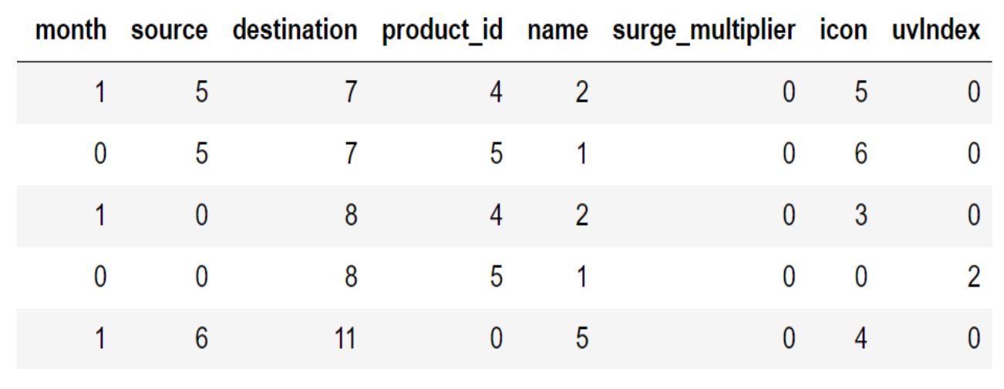
Final Dataset After Applying RFE

Slide 23
Modeling
After Completion of Recursive Feature Elimination process, we can done Modeling on final dataset. We use four types of Models
1. Linear Regression
2. Decision Tree
3. Random Forest
4. Gradient Boosting Regressor

Slide 24
After applying different models on final dataset, we found different accuracy as given below :-
Serial No. | Models | Accuracy
1 | Linear Regression | 0.7578915690209413
2 | Decision Tree | 0.9605524230411967
3 | Random Forest | 0.9610441804498846
4 | Gradient Boosting Regressor | 0.9621167871791544

Slide 25
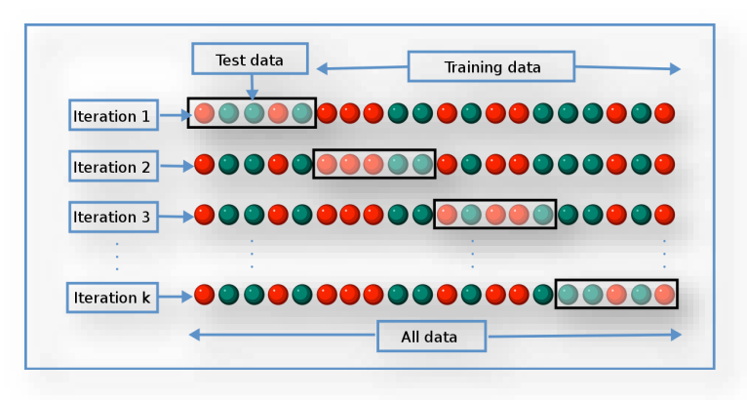
K-fold Cross Validation

Slide 26

Testing
The usage of the word "testing" in relation to machine learning models is primarily used for testing the model performance in terms of accuracy/precision of the model.

Slide 27
With the help of random forest model, we predict the price, plot a graph between actual and predicted values and find the following errors:-
For linear regression:-
MAE : 3.0513559138286173
MSE : 18.61467577320386
RMAE : 4.31447282680096
For random forest:-
MAE : 0.998140620865906
MSE : 2.9447657109843504
RMAE : 1.7160319667722832

Slide 28
Price Prediction Function
At last, we create a function for price prediction which take cab name, source, surge multiplier and icon as input and predict the price.

Slide 29
Conclusion
We apply four different models on our remaining dataset among which Decision Tree, Random Forest, and Gradient Boosting Regressor prove best with 96%+ accuracy on training for our model. This means the predictive power of all these three algorithms in this dataset with the chosen features is very high but in the end, we go with random forest because it does not prone to overfitting and design a function with the help of the same model to predict the price

Slide 30
Future Enhancements
Incorporate Price Data
2. Include Other Cab Price Variations
3. Incorporate Weather Data
4. Explore Additional Feature Engineering
5. Implement Online Price Prediction Functionality

Slide 31
Limitations
Limited insights
2. Lack of data on taxi prices
3. Lack of data on price variations of other cabs
4. Limited data on weather
5. Subjective feature selection

Slide 32


